Slide 1


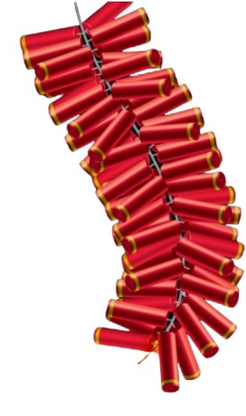

Notes:
Row of lights
Signifies the victory of good over the evil, light over the darkness.
Good = Light
Darkness = Evil

Slide 2

DAY 1
November 12, 2023

Slide 3
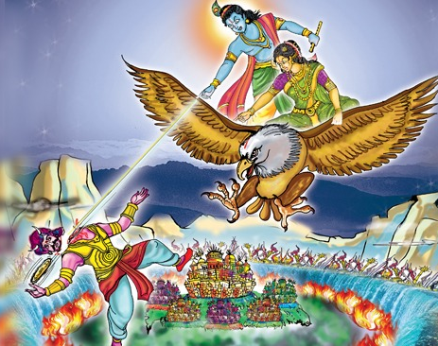
Lord - Krishna
Wife - Satyabhama
Demon King - Naraka

Slide 4
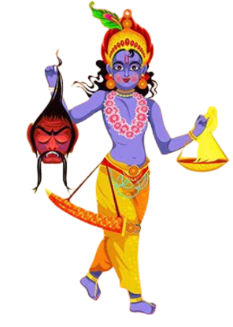
Oil Bath – After killing Naraka

Slide 5
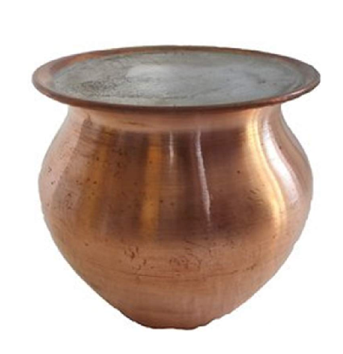
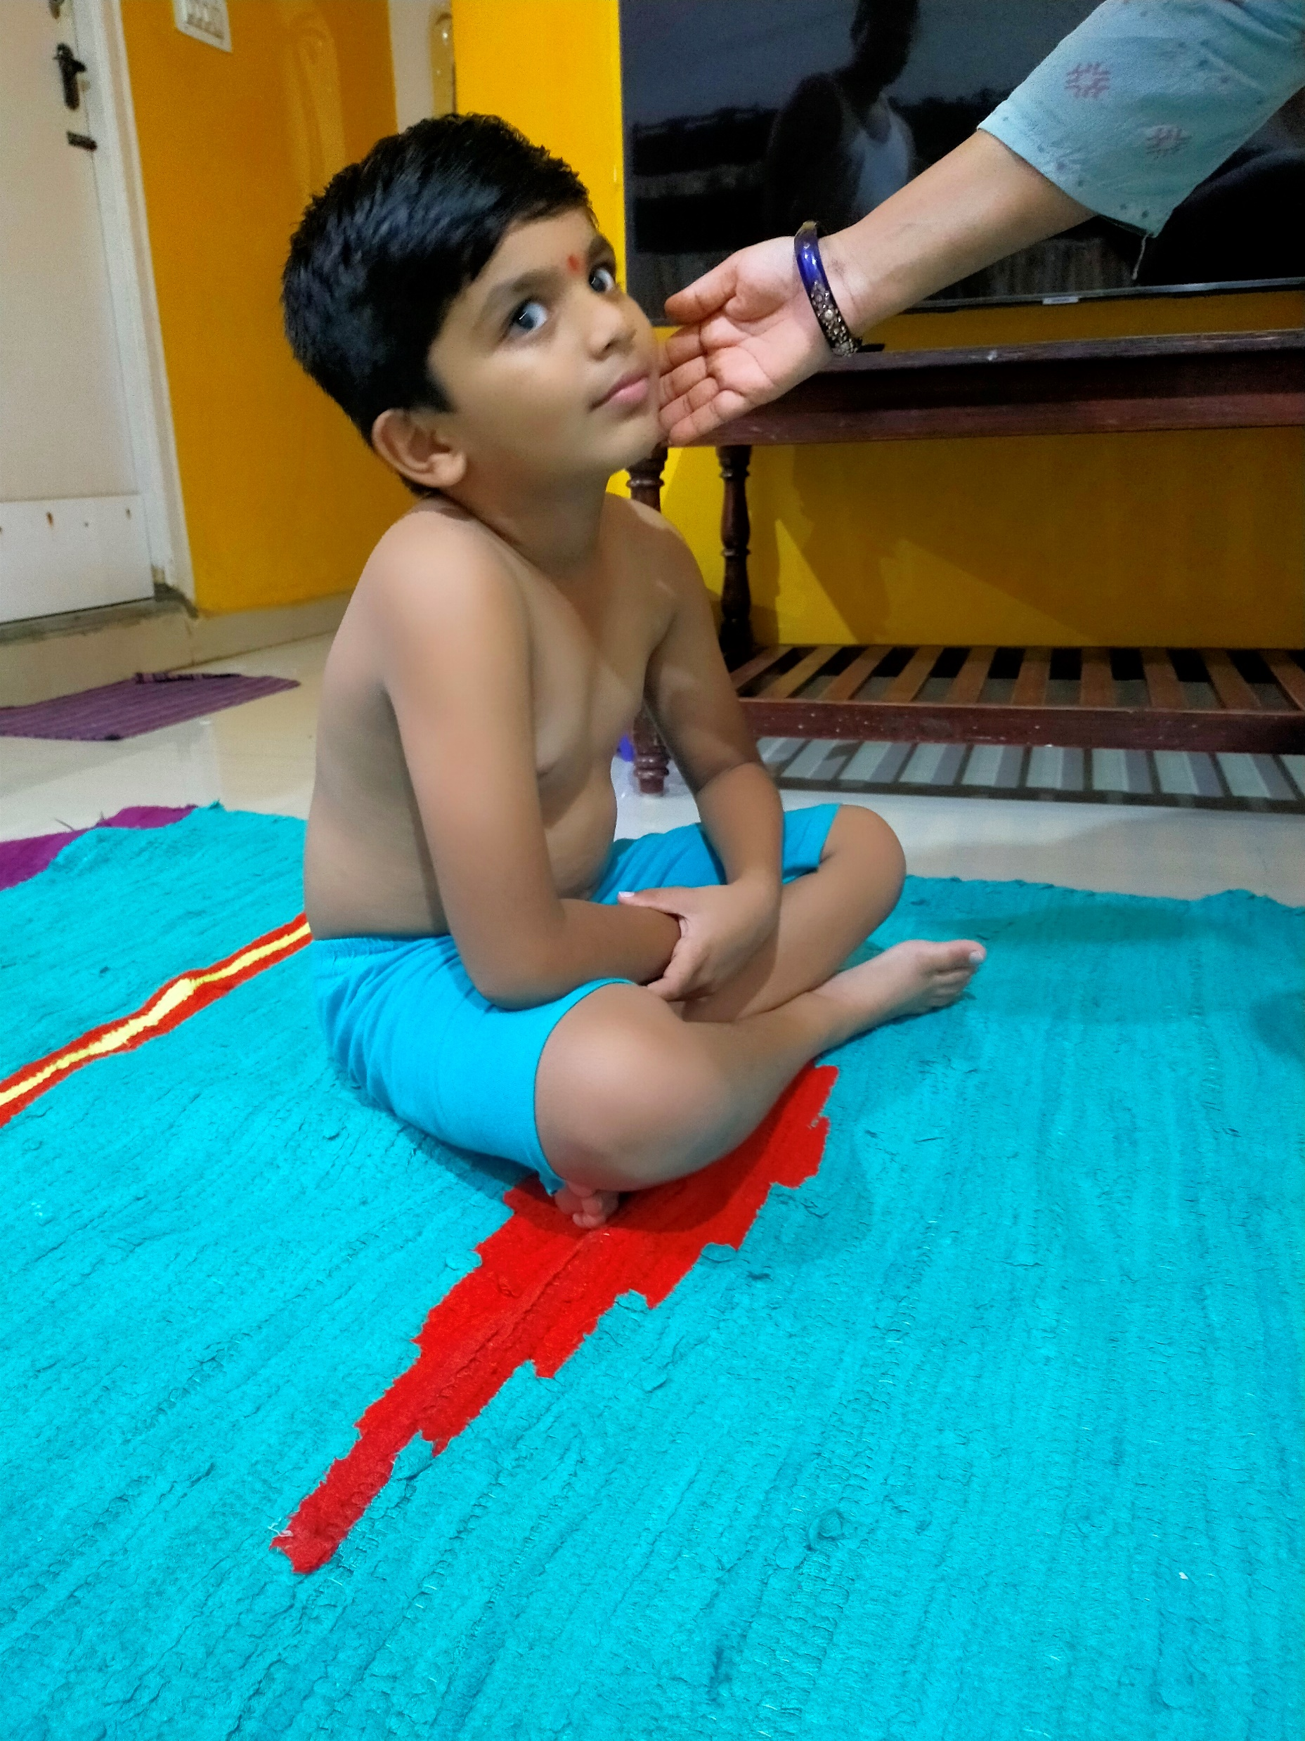
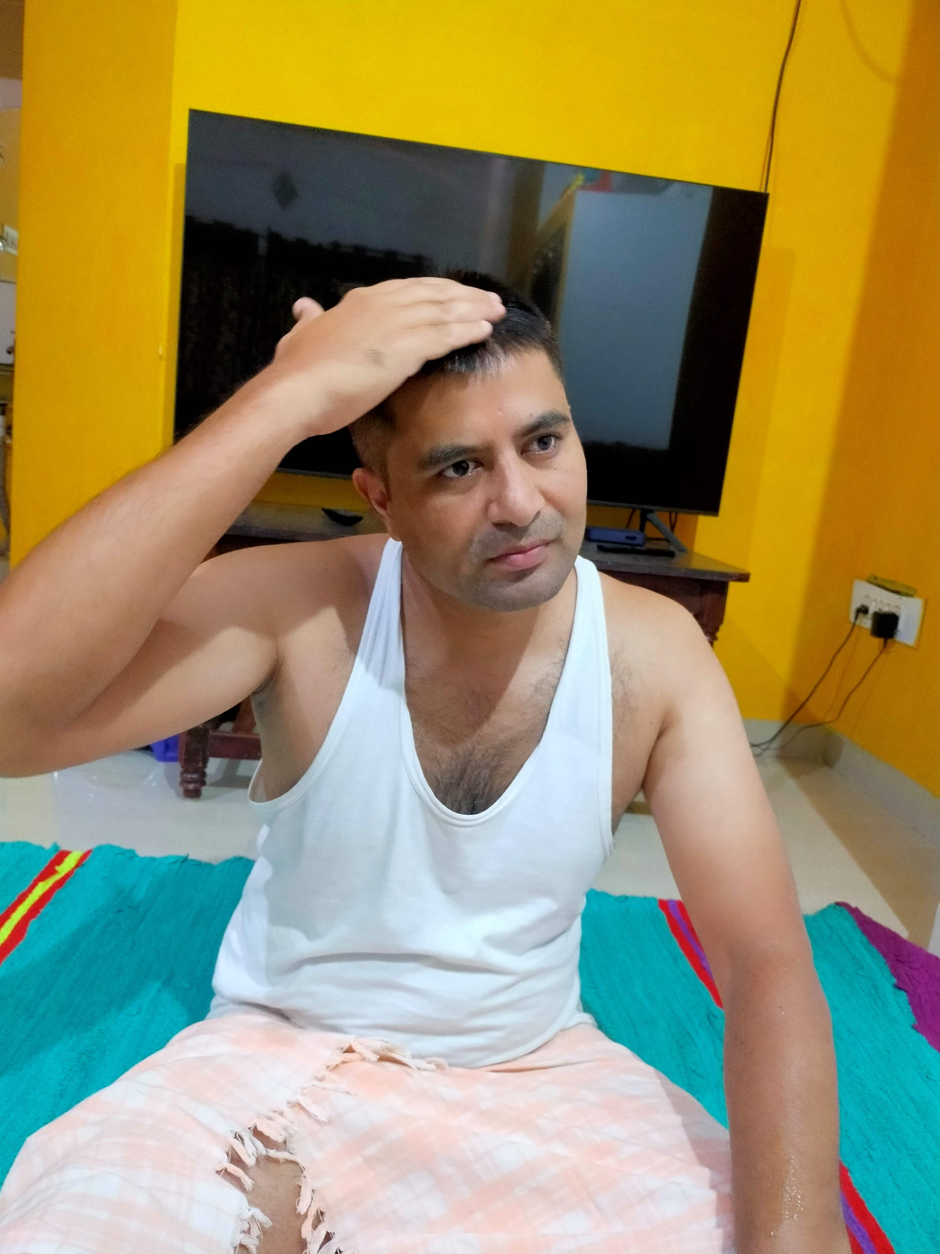
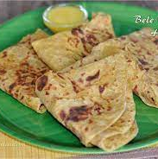
Oil Bath
Holy Water – Ganga River
Sweet – Obbattu, also called Holige

Slide 6
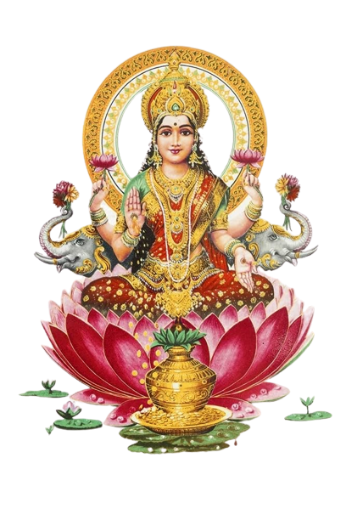
Day 2, November 14
Lakshmi Worship

Slide 7
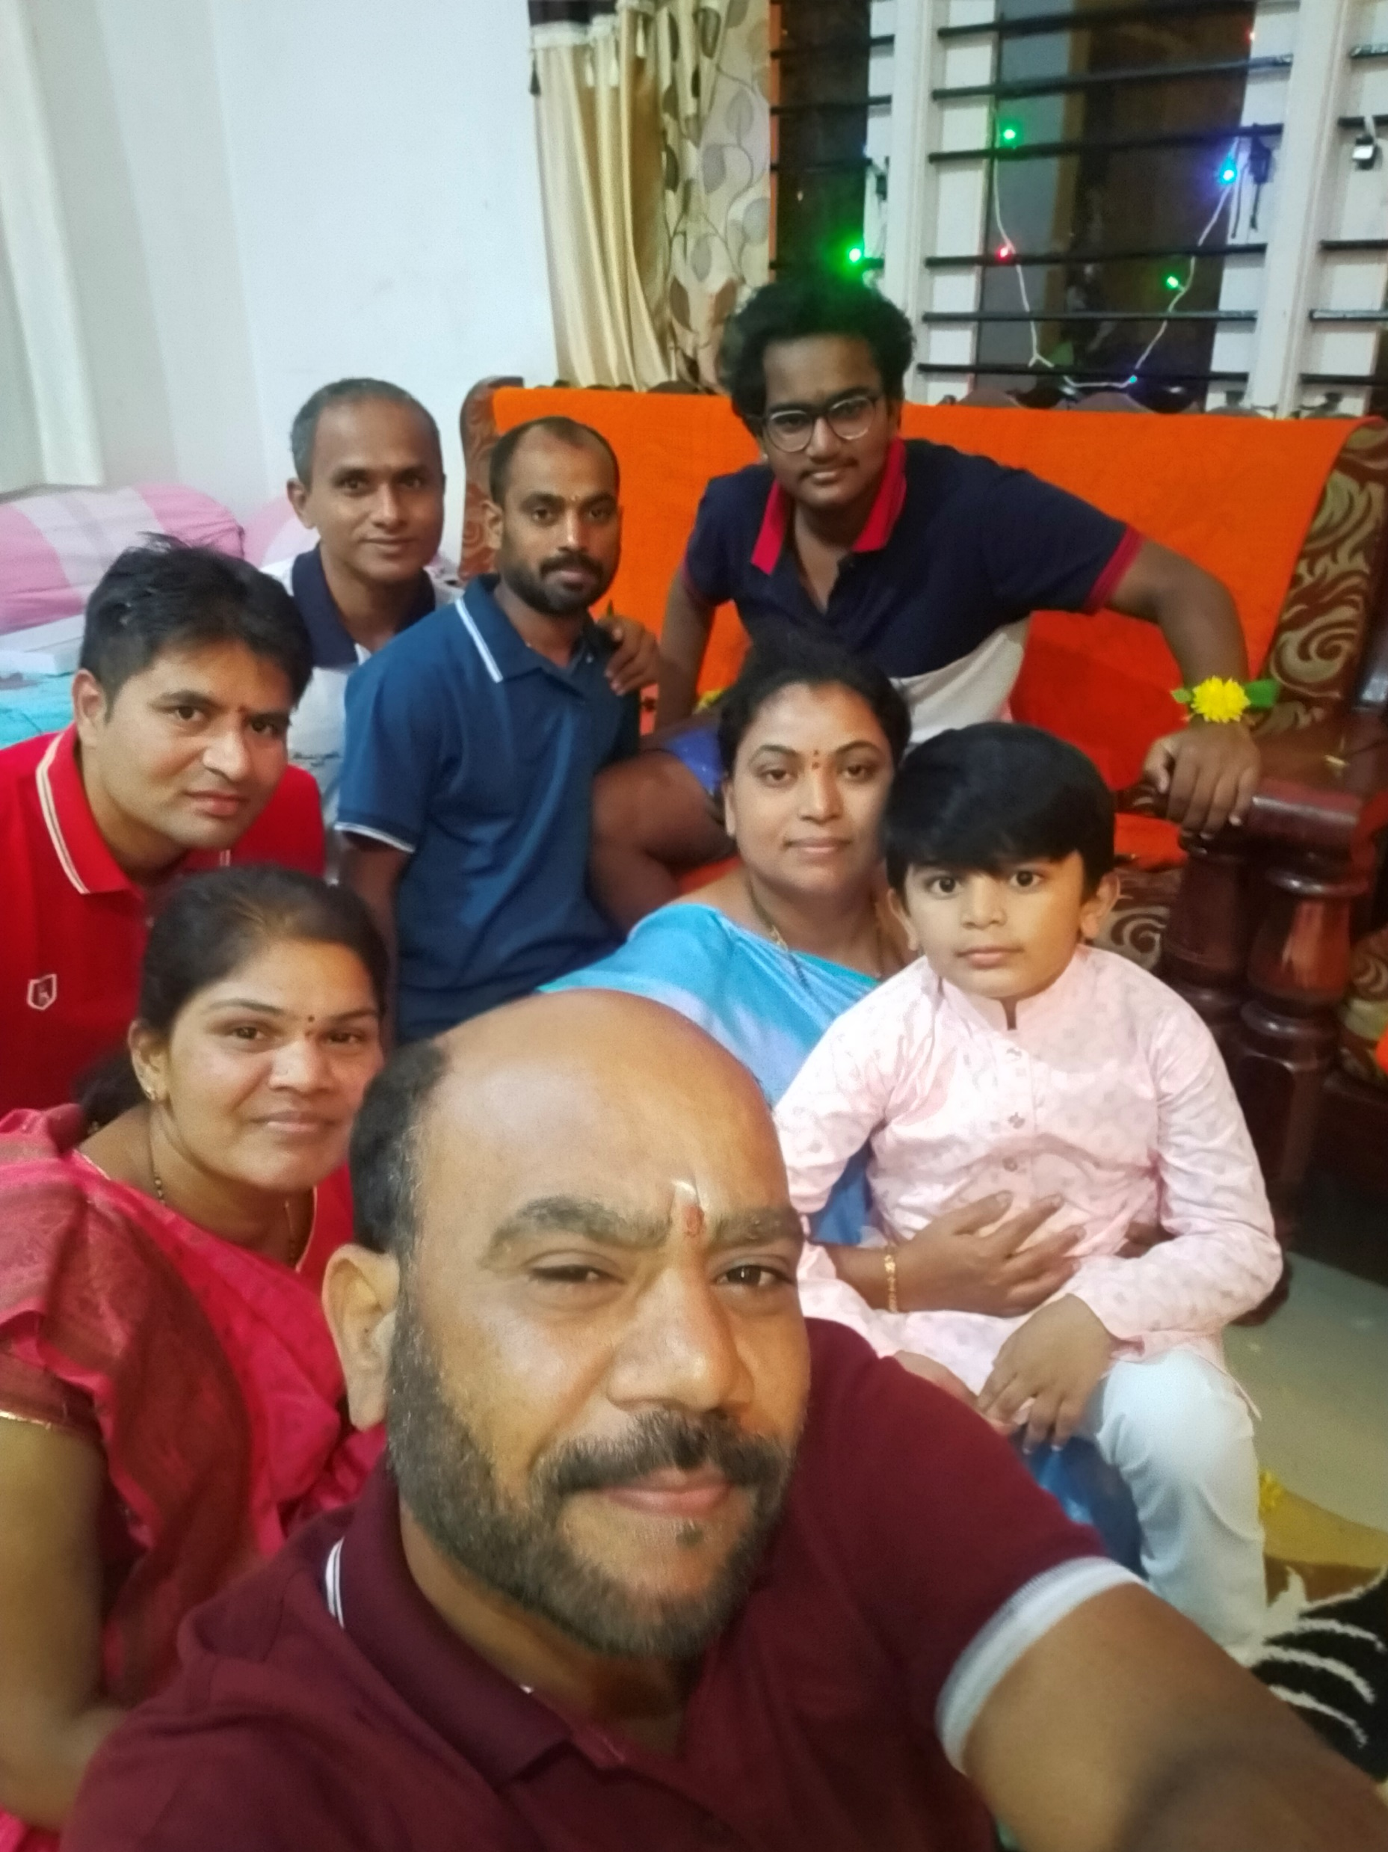
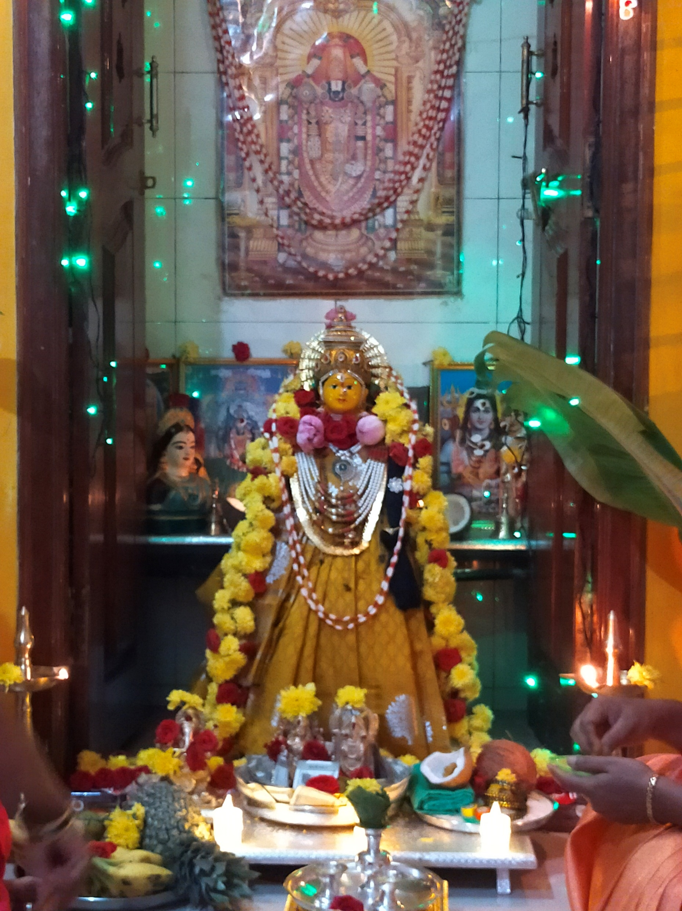

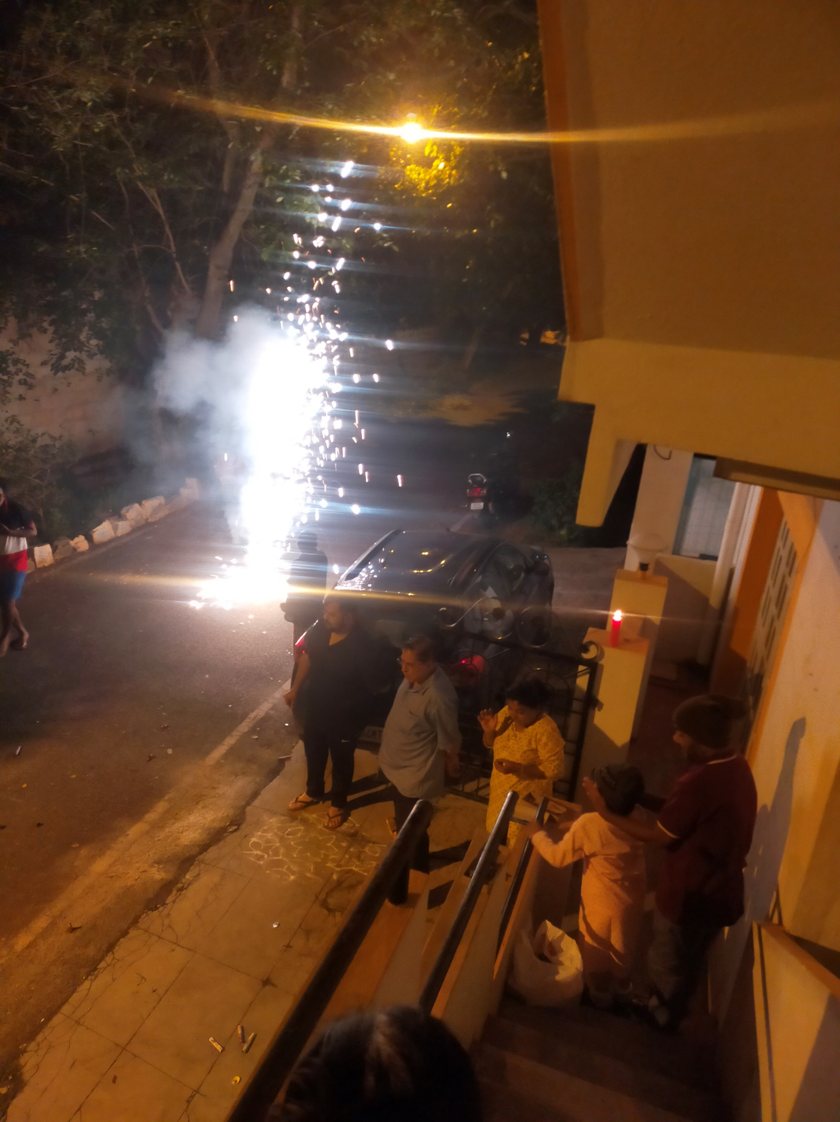
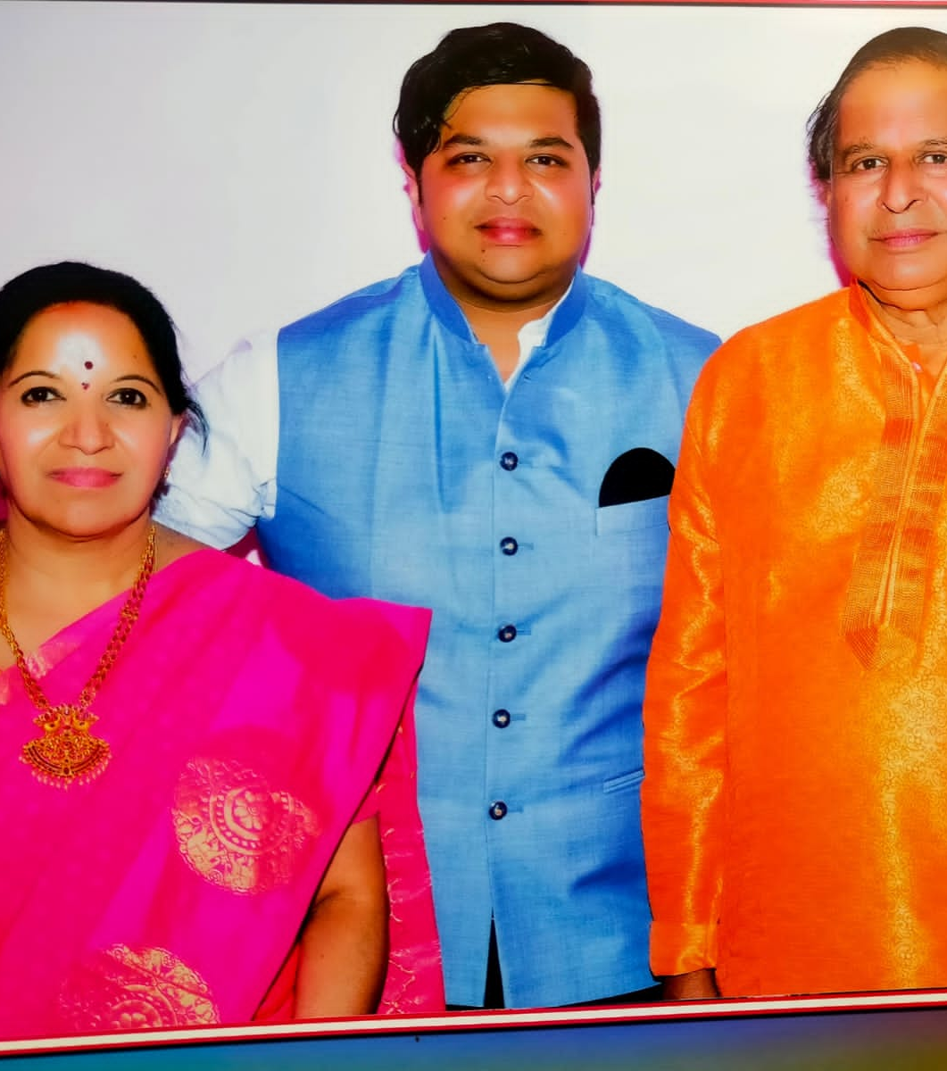
Goddess Mahalaxmi Worship and Decoration
Sand Art
Pot
Coconut
Saree Draping
Face
Garland
Accessories
Food Offerings
Fruits
Home Prepared Sweets
Wearing New Dresses
Burst Crackers

Slide 8
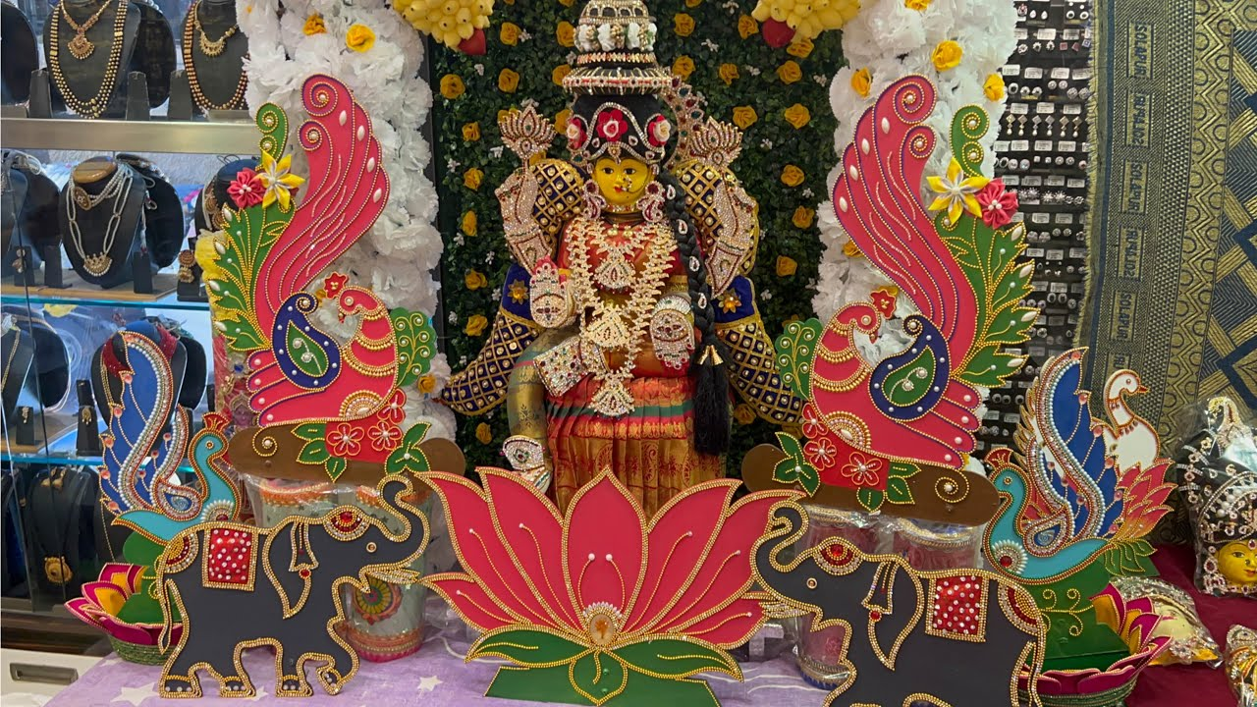
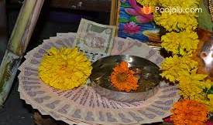
Shop Decoration
Cash Worship

Slide 9
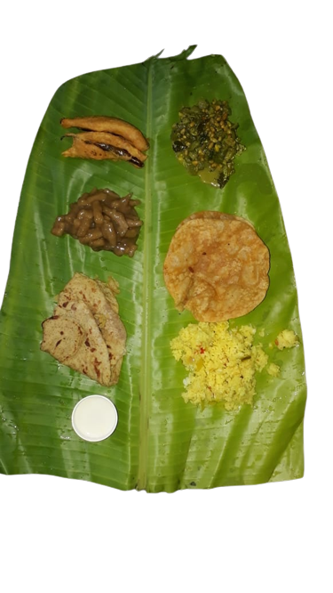
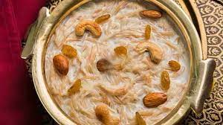
Shekarane (Sweet milk made of Banana and Sugar)
Brown Holige
Shavanagi Payasa (Wheat flour taped pudding)
Mirchi Bajji (Deep- oil fried chilli)
Chitranna (Lemon Rice)
Poori (Deep oil fried bread)
Hesaru Kalu Palya (Green Gram Curry)
Shavige (Vermicelli) Payasa (Pudding)

Slide 10
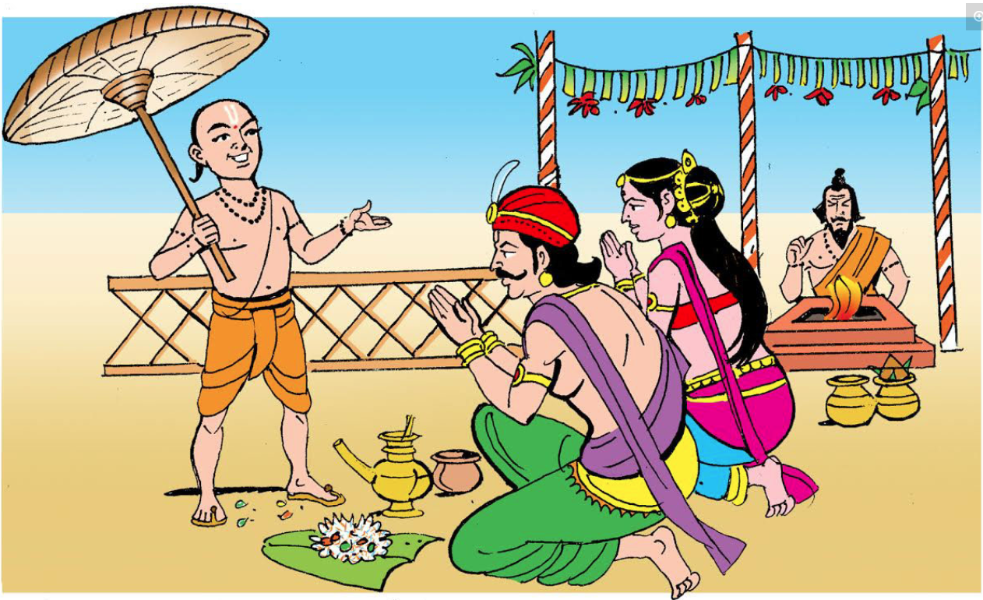
Bali Pratipada November 15, 2023
14 NOVEMBER 2023
Lord Vishnu came in Vamana (small boy) Avatar (reincarnation)
Bali – Daemon King
Vindyavalli – Wife
Bali and his wife performing yagna (fire worship) overseen by a Rishi (sage).

Slide 11
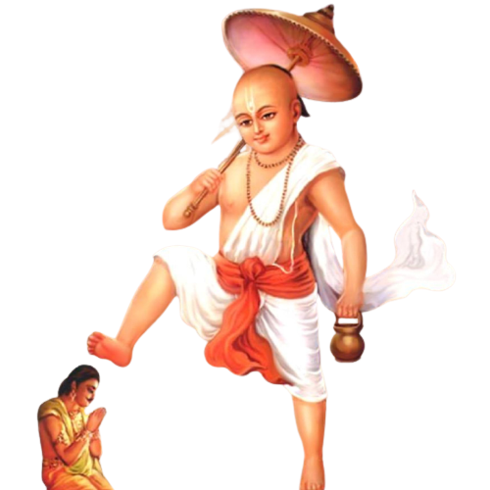
3 Steps
1st step covering the entire earth
2nd step covering the entire universe
3rd step on Bali’s head

Slide 12
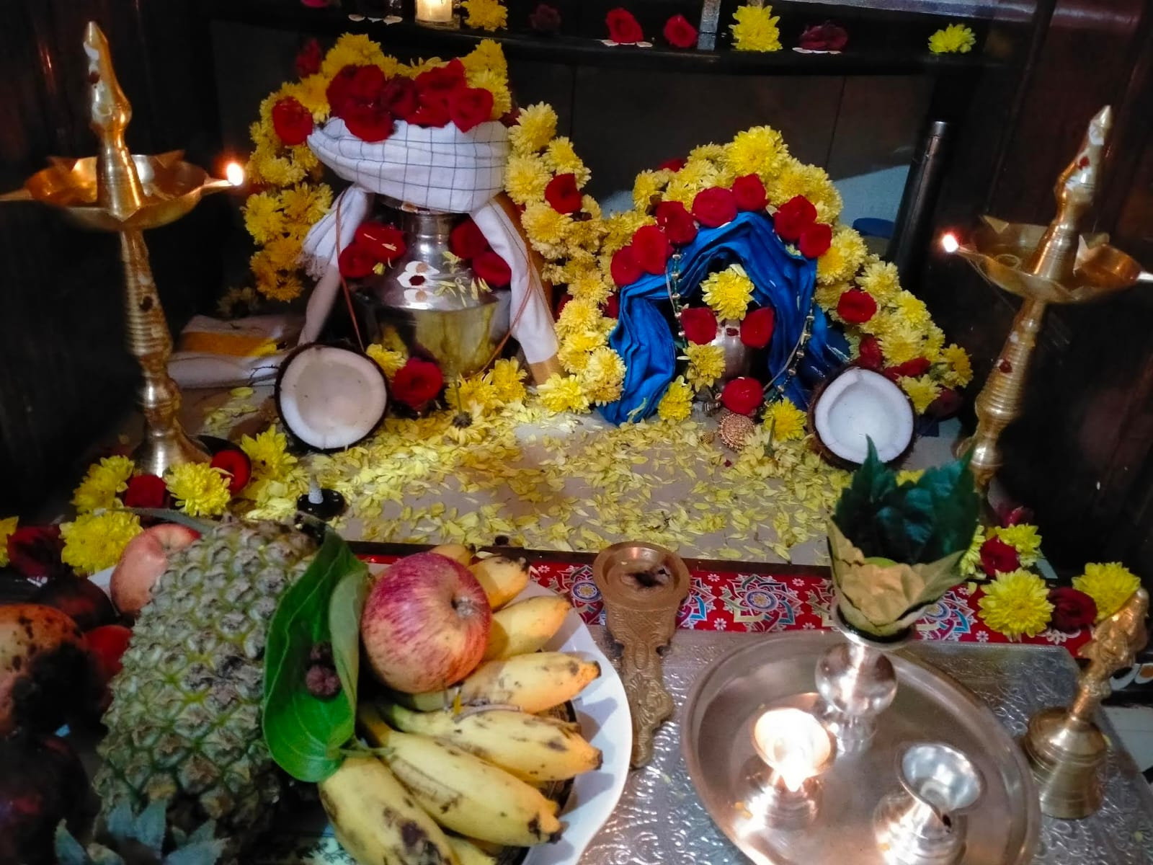
Ancestor Worship
Sand Art (Rangoli)
Pot
Coconut
Turban/Saree Draping
Flower Decoration
Fruits and Prepared Dishes for Naivedya
Clothes
Aarti (Fire Light ceremony)
Agarbathi (Incense Stick) ceremony

Slide 13
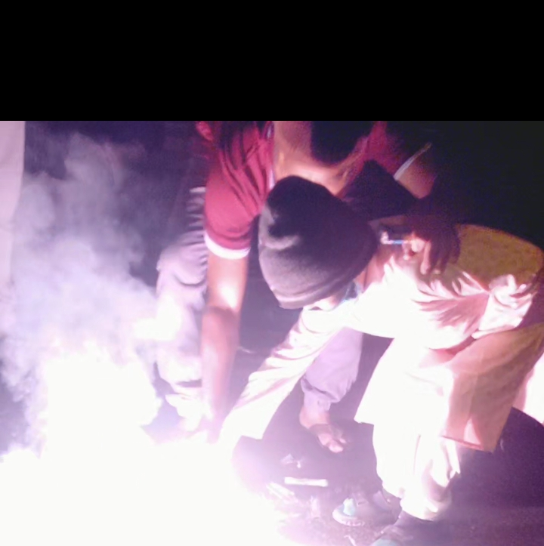
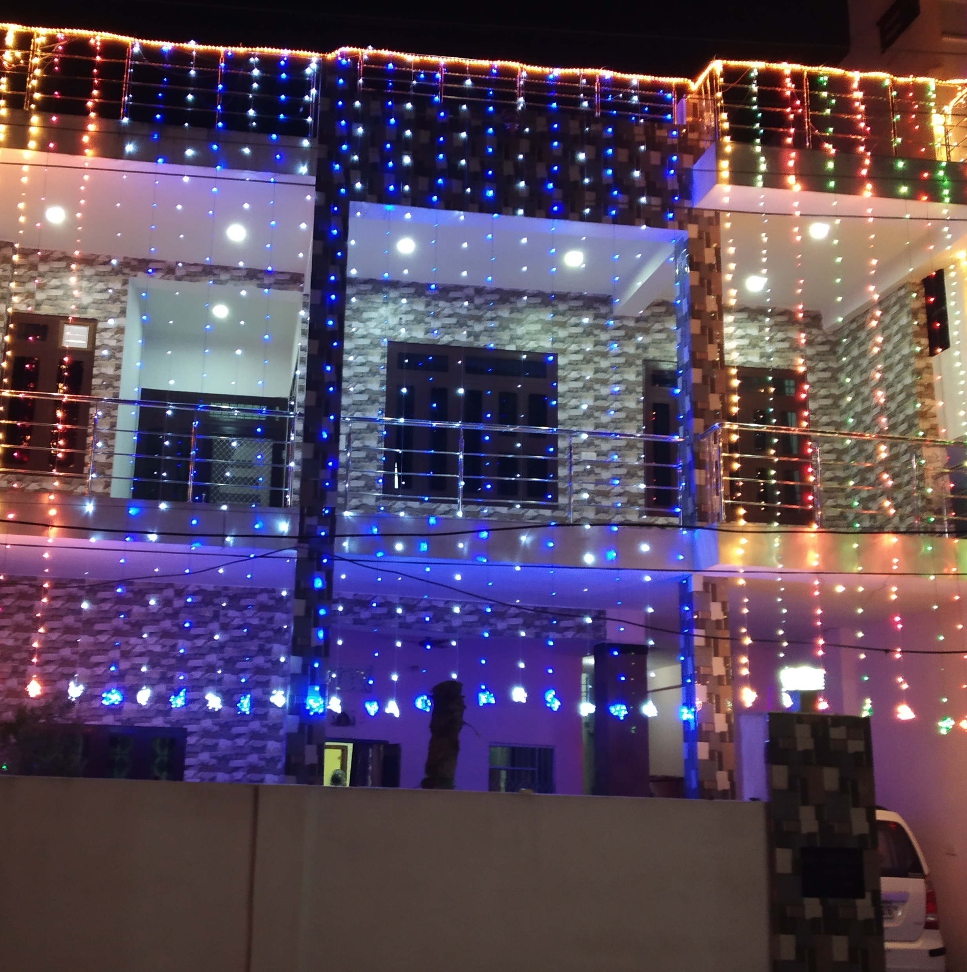
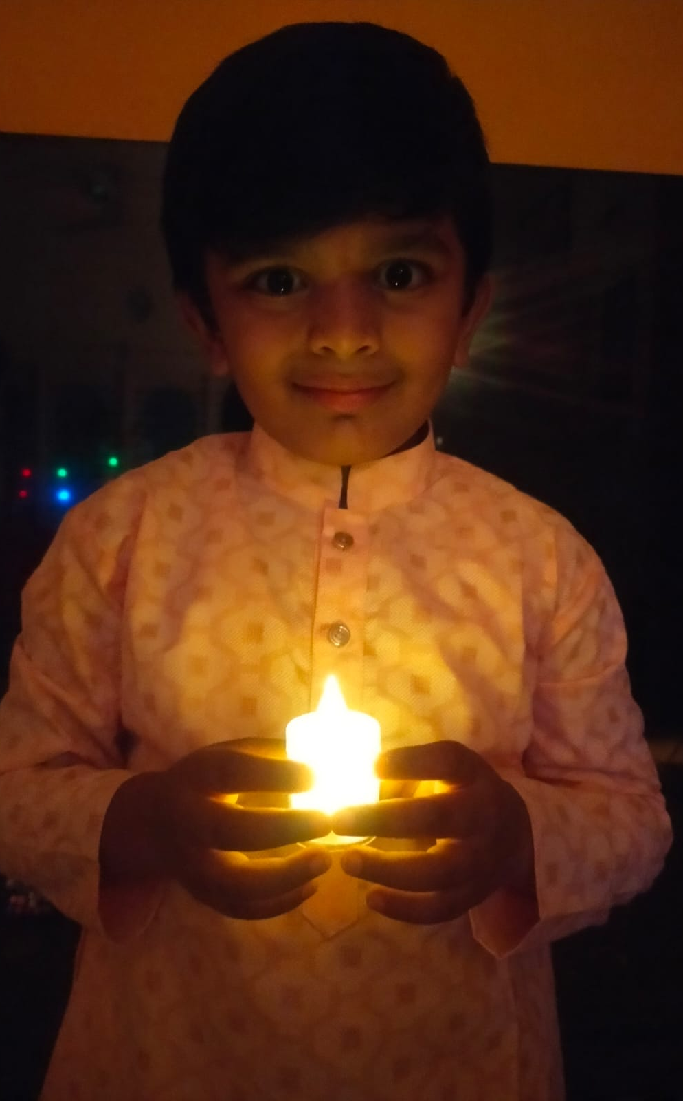
Home Lighted
New Dresses
Firing Crackers

Slide 14
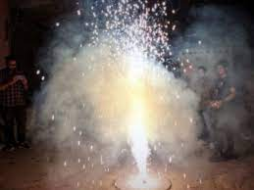
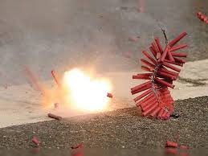
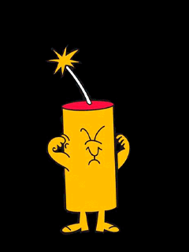

Food Offering for the God
Bali Pratipada
Oil Bath & Obbattu
Mahalakshmi Worship
Ancestor Worship
Naivedya
Money Notes Offering
Naraka Chaturdashi

Slide 15
